Slide 1
Predator-Prey Dynamics

Slide 2
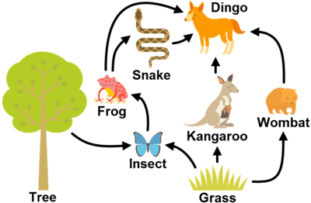
Everything within an ecosystem is interdependent.
That means that changes in one aspect of the ecosystem can affect every species.

Slide 3
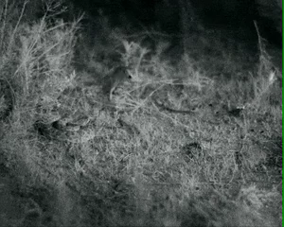
Predator-prey dynamics are just one example of how changes in the ecosystem can affect two different species.
Predation is the biological interaction where one organism consumes another.

Slide 4
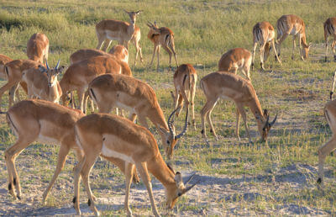
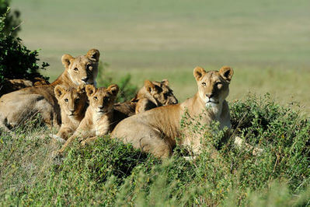
Predation moves energy through a food chain.
It is an important interaction in ecology because it helps to control prey population size. It also provides energy to predators, allowing them to have more offspring.

Slide 5
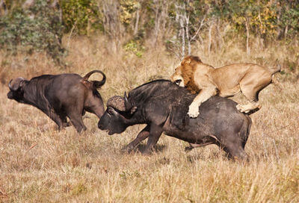
Predation allows energy to flow from one trophic level to the next. However only 10% of the energy from the prey item is passed on to the predator. The remaining energy is lost to the environment.
As the trophic level increases, the total mass of the organisms in that level decreases. That means the prey population is always larger than the corresponding predator population.

